Slide 1
GIS for Geoscientists Session 1: Why GIS?
Image Credit: Patrick Kennelly, Montana Bureau of Mines and Geology
Presented by Nicholas Barber, 3rd Year PhD Student at the University of Cambridge, U.K.
ndb38@cam.ac.uk | www.volcannick.com | https://github.com/ndb38 | Twitter @volcannick

Slide 2



Acknowledgements
Credit goes to Cat Crotty and the McGill SEG for helping me develop this course originally.
Special thanks to Alex Copley for seeking me out, and putting together the logistics for these lectures.

Slide 3
Course Structure
Today: Session 1 – Principles and Motivation for GIS in the Geosciences
Why GIS?
Principles of GIS
Getting acquainted with Quantum GIS
Thursday November 5th: Session 2 – Beginner GIS Exercises
Tour of Interface
Guagua Pichincha Hazard Assessment
Tuesday November 10th: Session 3 – Intermediate GIS Exercises
Geoprocessing
Spatial Analysis
Data Management
Advanced formatting
Thursday November 12th: Advanced GIS Exercises (Work in Progress)
Geostatistics
Python
Models
Databases
Q&A

Slide 4
Post-Lecture Feedback
After this lecture, please follow this link to provide me with some feedback on my teaching style: https://forms.gle/JP23T5J9RA36WzCg6
I want to improve as an instructor, and your feedback will be sued to improve future teaching practice

Slide 5
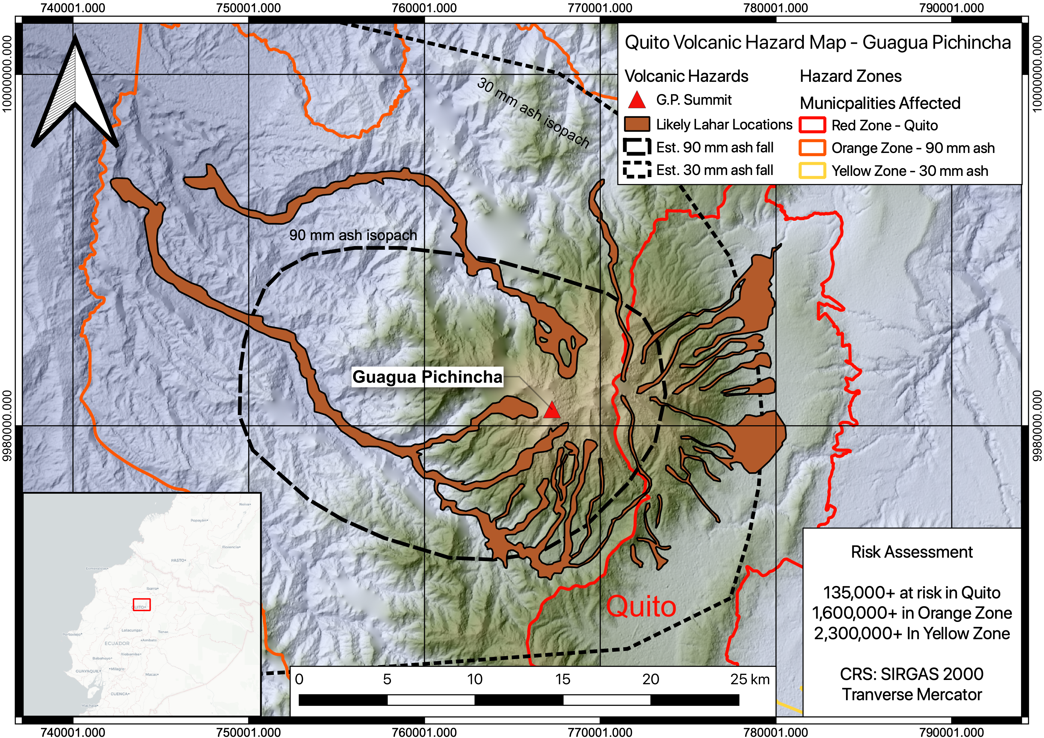

Slide 6
You will be able to make this map!

Slide 7
Outline of Today’s Session
Objectives (10 Minutes)
My Background (10 Minutes)
Why GIS? (15 Minutes)
Principles of GIS (45 Minutes)
Whirlwind Intro to QGIS
(20 Minutes)

Slide 8
Objectives
GIS = Geographic Information System
Definition:
“A GIS is a computer-based system to aid
in the collection, maintenance, storage,
analysis, output, and distribution of spatial
data and information.” – Paul Bolstad (GIS Fundamentals)

Slide 9
Questions you may have going into this course:
What is GIS?
What can it do for me and my studies? My future career?
What’s the best GIS software?
How do I learn the ins and outs?
Topics raised from past courses:
What do I need to know about GIS for my job?
Which coordinate system is preferred?
How do I georeference a geological map?
How do I create a map of my field site?
Best practices for setting up a new project?
How do I automate QGIS tasks
with python scripts?
How do I connect to and query a cloud-based spatial database?

Slide 10
My goals over the next two weeks
Highlight what GIS can do for geoscientists
Outline the key principles of a geographic information system
Providing a fully guided GIS workflow template
Identify key areas of growth for GIS in geoscience research
https://github.com/ndb38/gis-for-geoscientists

Slide 11
If you take nothing else away from this course….
GIS is a helpful tool in your workflow if you have data with a spatial dimension
GIS software lets you store, collect, analyze, and share spatial data
Modern GIS platforms like ArcMap and QGIS are all around workhorses – essential to tasks like spatial modeling, database management, cartography, geodesy, data visualization, hazard mitigation, and story telling
Learning the capabilities of GIS is acquired from repeated, often frustrating, trial and error with the hundreds of built-in tools
Studies should be designed with the GIS end user in mind!!!

Slide 12
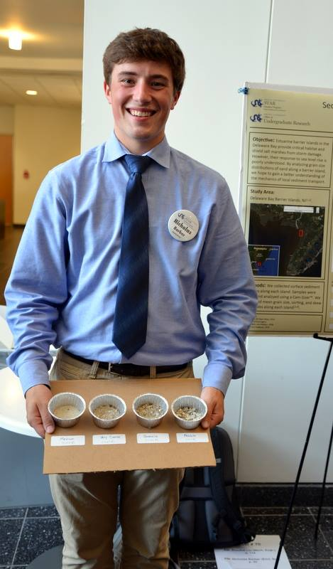
My Background
Past: B.S. Geoscience (Honors), Drexel University, USA
Current: PhD Earth Science, Cambridge, UK
Specialty Areas: Volcanology, Igneous Geochemistry
GIS Experience:
August 2014 - Present

Slide 13
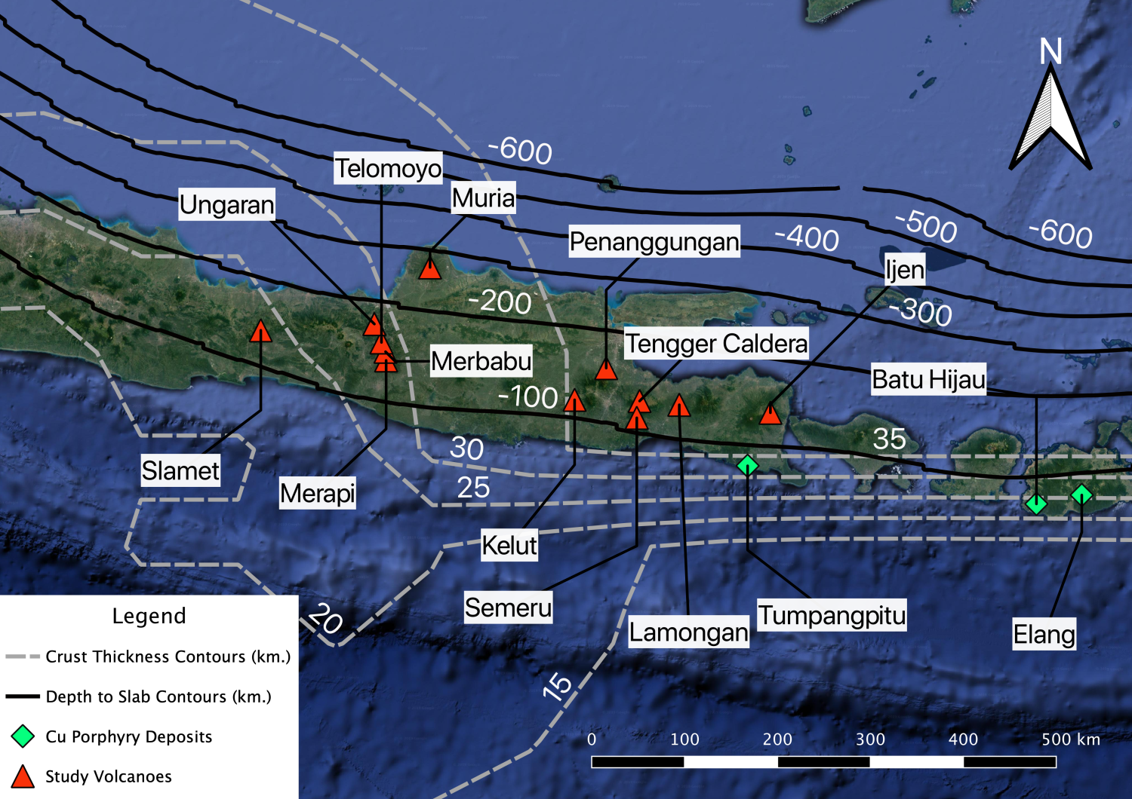
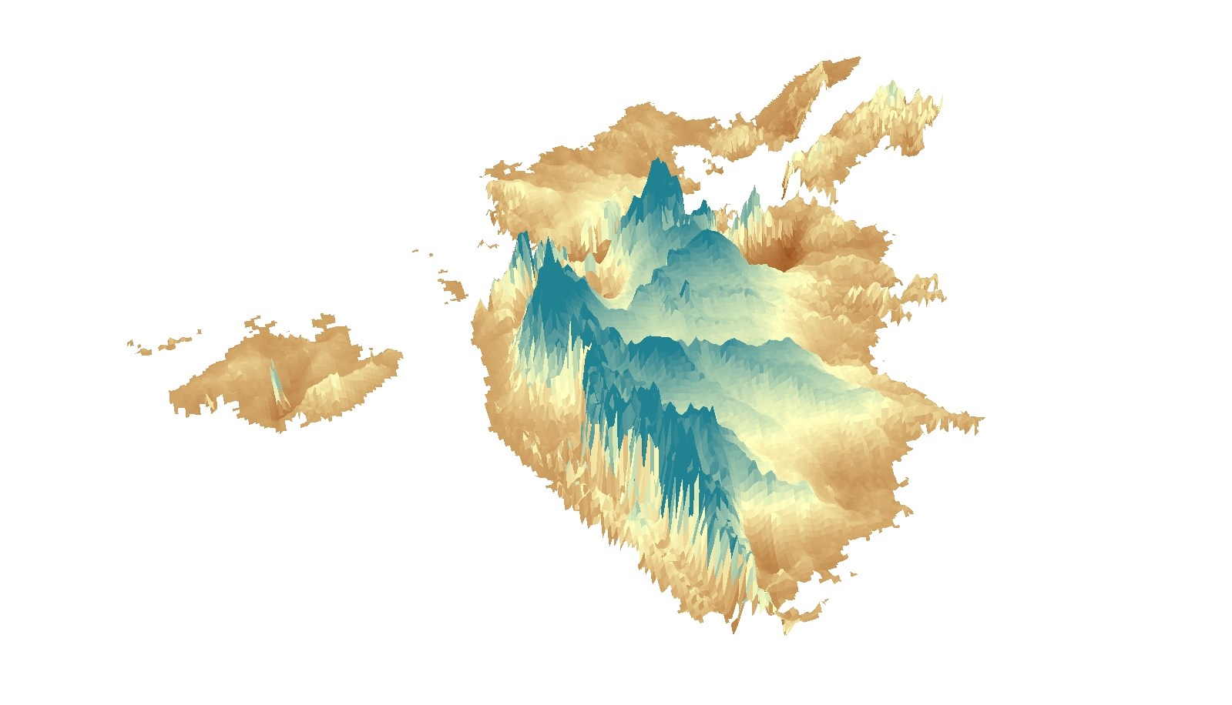
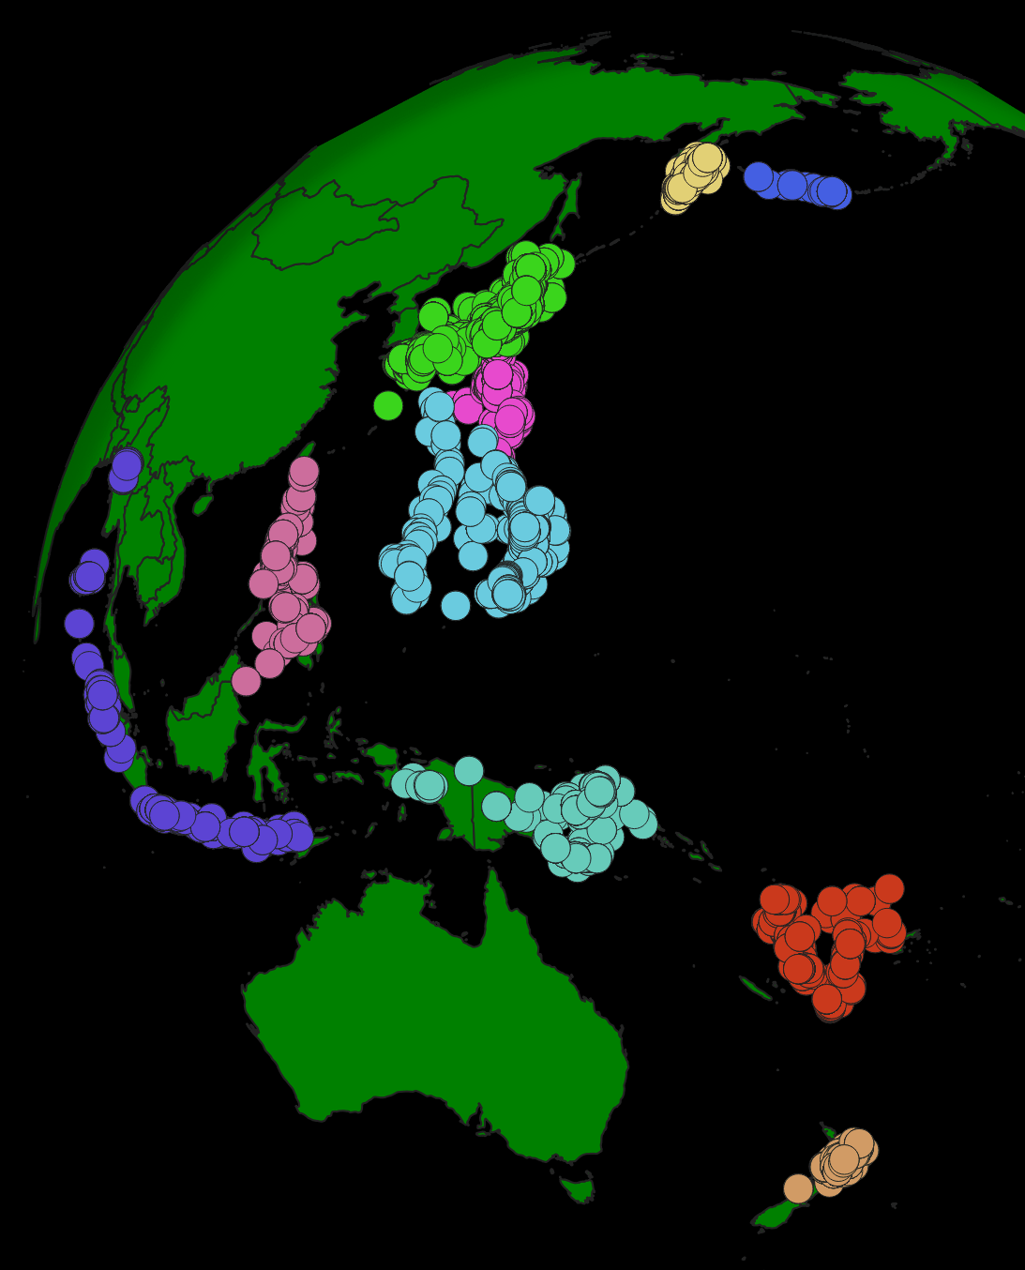
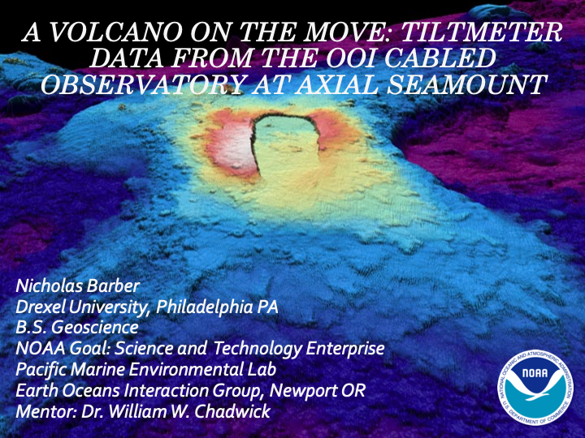
(Above) September 2018 to Present: Metals in Magmas Field Campaign, Java, Indonesia
(Below + Right) January 2016 to Present: Senior Project - Volume of Deccan Traps
(Right) August 2019 to Present): ArcMetals Global Arc Chemistry Database. Preprint is out!
(Right) May 2017 to August 2017: Deformation modeling with NOAA; Seafloor volcano Axial Seamount

Slide 14
Why GIS?
Motivations for the strapped-for-time earth scientist

Slide 15
Four reasons to use GIS
Job Prospects
Advancing your analysis
Making your data reusable
Story telling

Slide 16
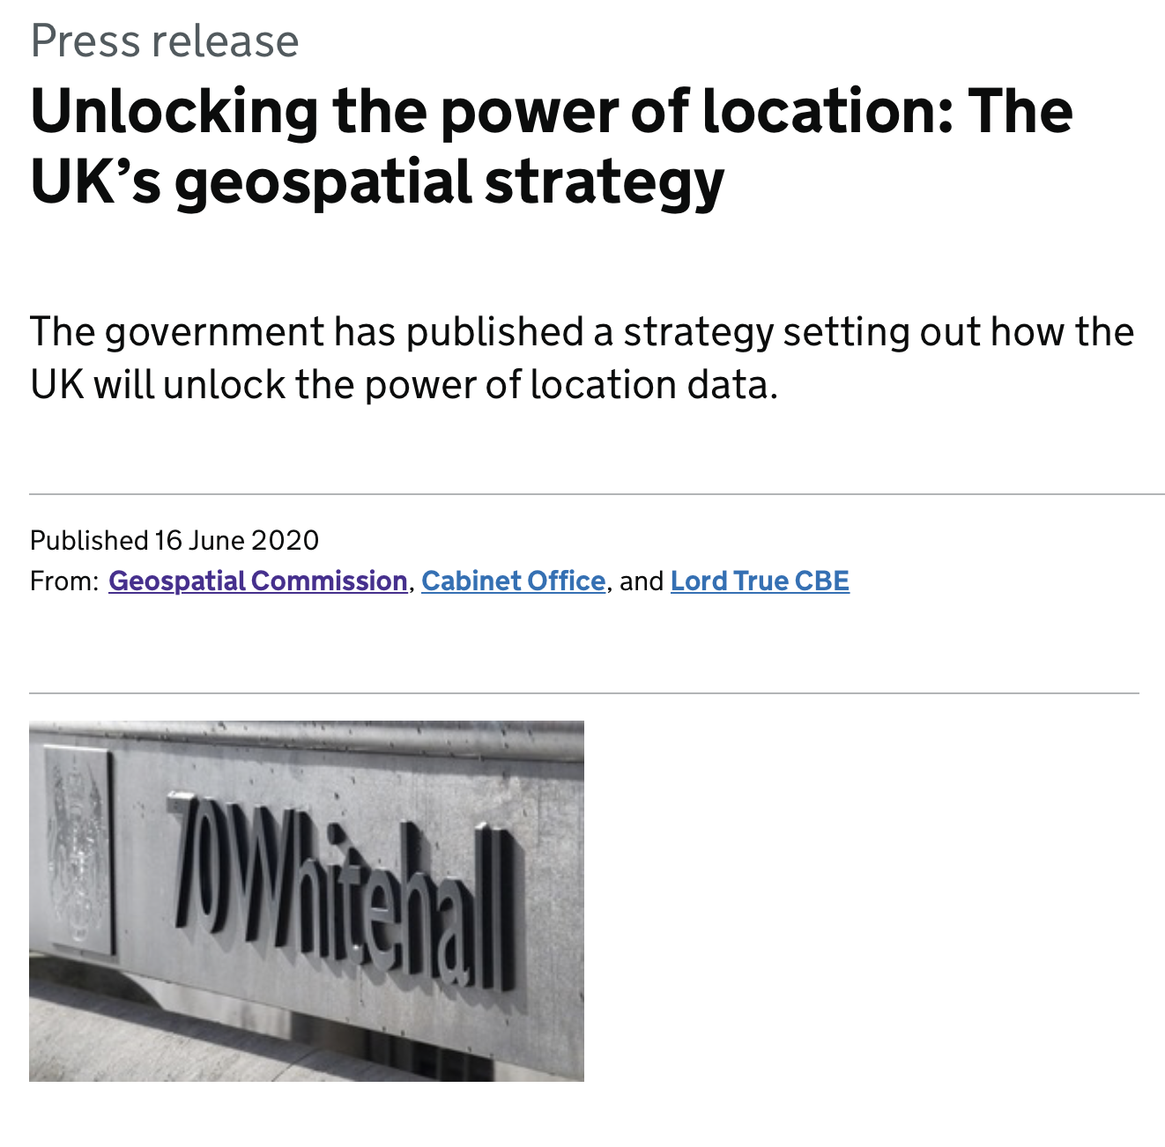
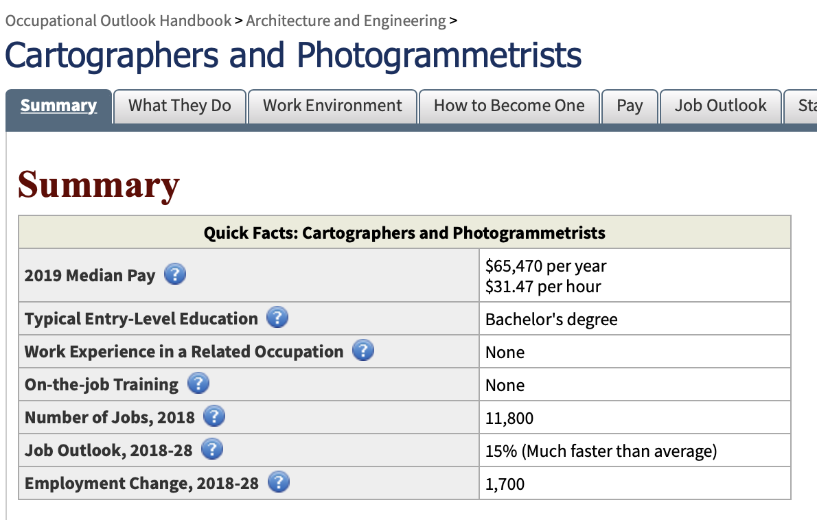
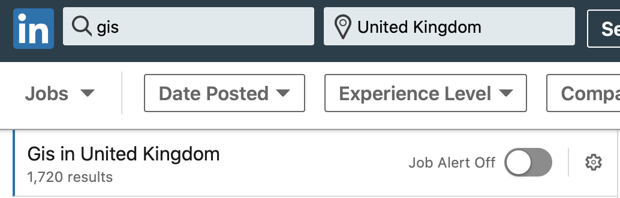
Job Prospects
Geospatial industry projected to grow to a value of $19 billion USD by 2024
Compound annual growth rate (CAGR) of over 10%
Geospatial industry targeted as a key area of growth by UK government
Employment for GIS specialists outstripping average employment growth
Geological Society of London highlights GIS alongside drawing software and programming skills as essential skills in careers for geologists

Slide 17
Job Prospects
Learning how to properly use GIS takes time and patience. That translates to value for any employer (academic private, public)
Positioning yourself as a geologist with GIS awareness increases your utility in any organization

Slide 18
Advancing your analysis
Economic Geology:
Determining cost/environmental impact of a new mine (water resources, accessibility, topography, water table, population centers, municipal boundaries)
Volcanology
Mapping risk posed by different eruption scenarios
Environmental Geology
Modeling the risk posed by a pollutant at a great distance from pollution source
Sedimentology
Mapping known outcrops to determine where the same formation will appear outside study area
Geophysics + Structural geology
Integrate stress models and seismic focal mechanisms with known geology + chemistry
Public Policy, Infrastructure, Conservation, COVID Tracking, App Usage….

Slide 19
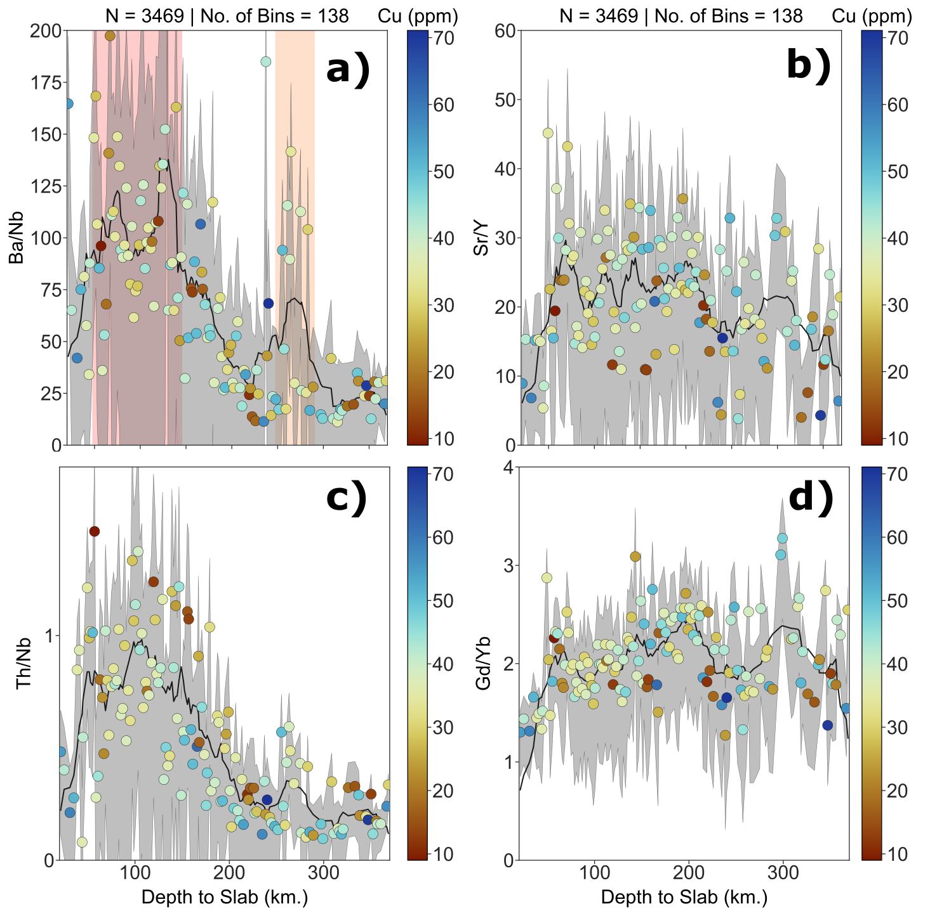
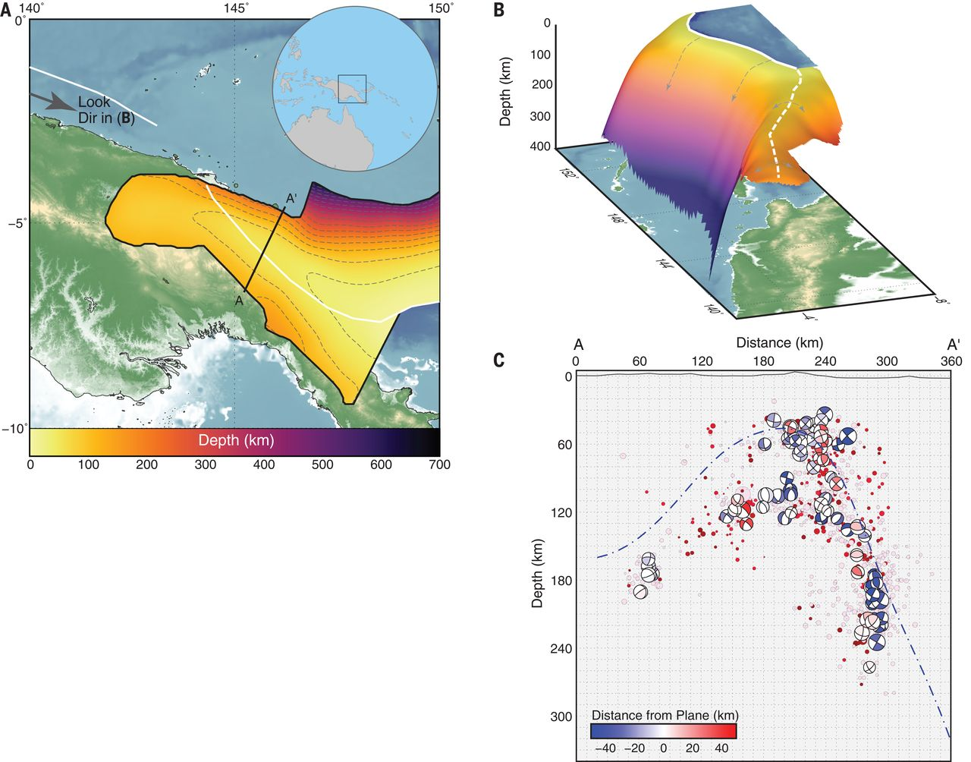

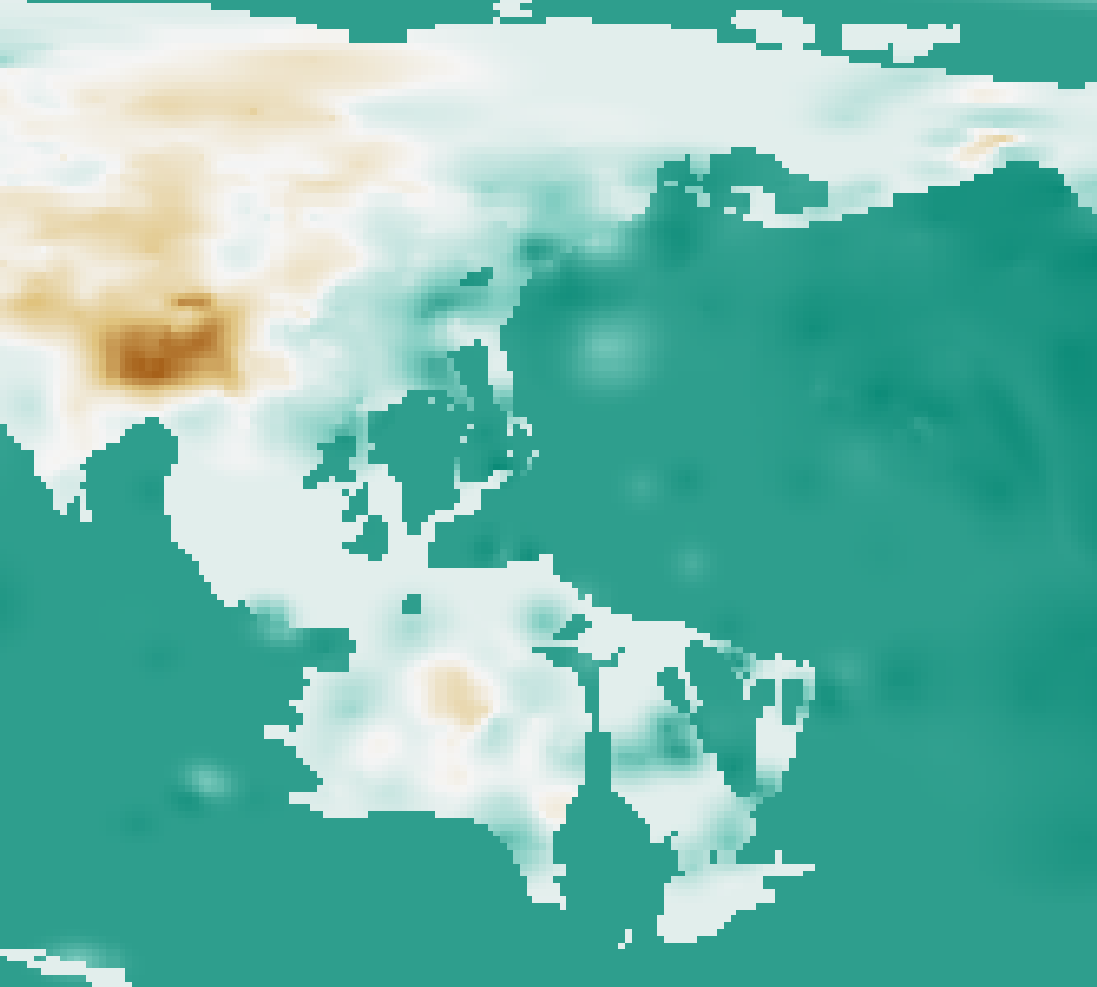
Example: ArcMetals Database
Data sources: GEOROC, Hayes et al. 2018 (Science), Szwilllus et al. 2019 (JGR), Barber et al. 2020 (in prep.)

Slide 20
Making Data Reusable
As earth scientists, everything we do is spatial
Open Data and Data Reproducibility one of the biggest concerns/frontiers in science today
If you aren’t building spatial metadata/analyses into your workflow, your work isn’t reproducible by other earth scientists!

Slide 21
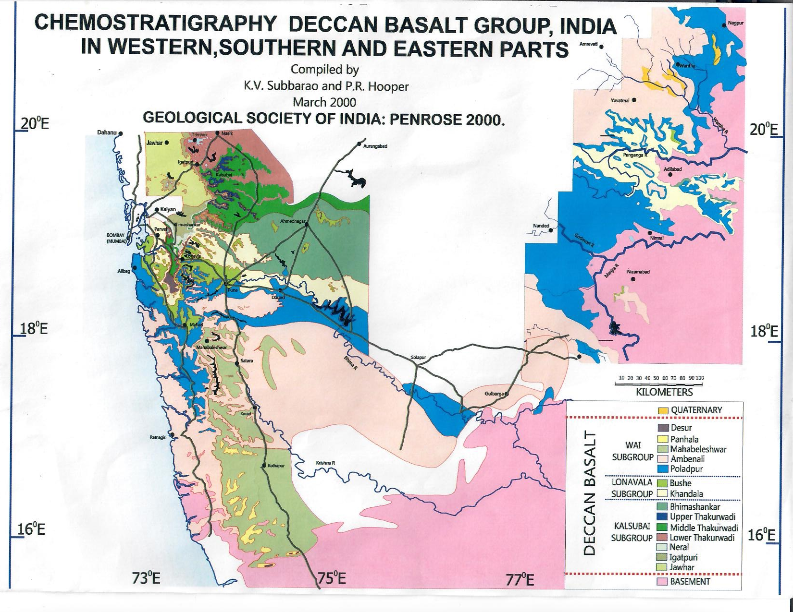
Example: Stratigraphy of the Deccan Traps

Slide 22
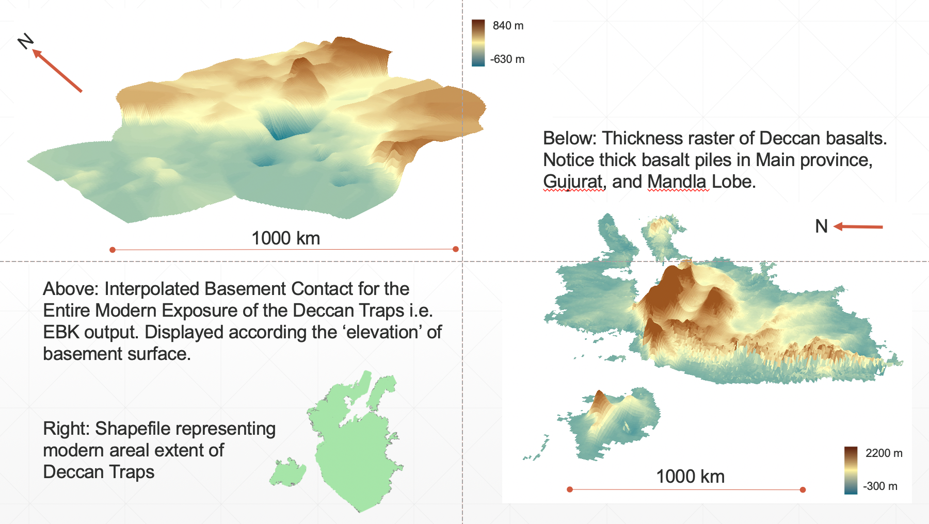
Example: Stratigraphy of the Deccan Traps

Slide 23
Story Telling + Communication
Underlying link of our data to the wider world makes for compelling stories
Integrating GIS into your research lets you tell stories rooted in place, time, and culture
Story Maps from ESRI:
ESRI (ArcGIS) has developed digital story telling format the leverages this capacity
Alternative way to present your research
Let the maps tell your story

Slide 24
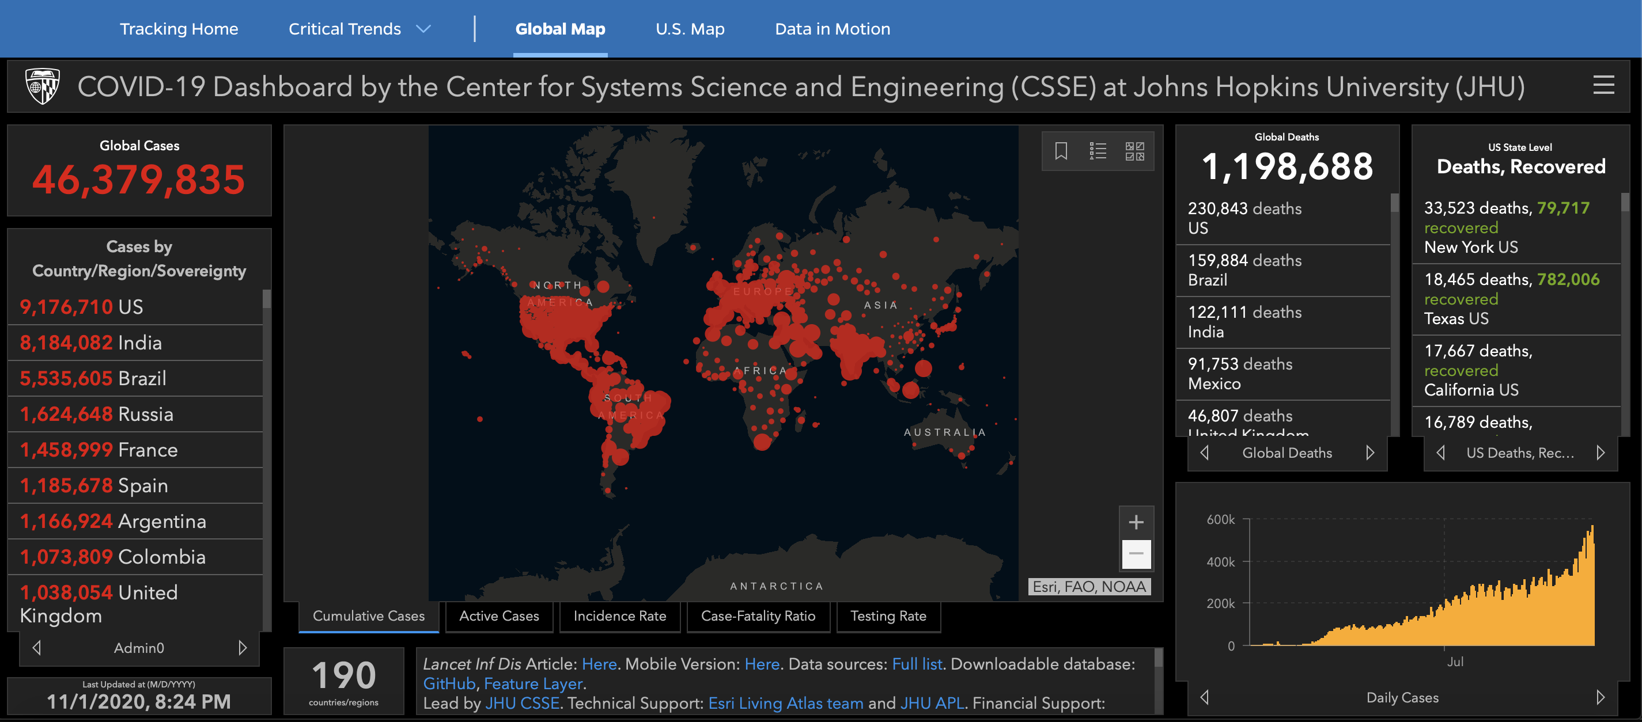
Johns Hopkins University GIS Dashboard

Slide 25
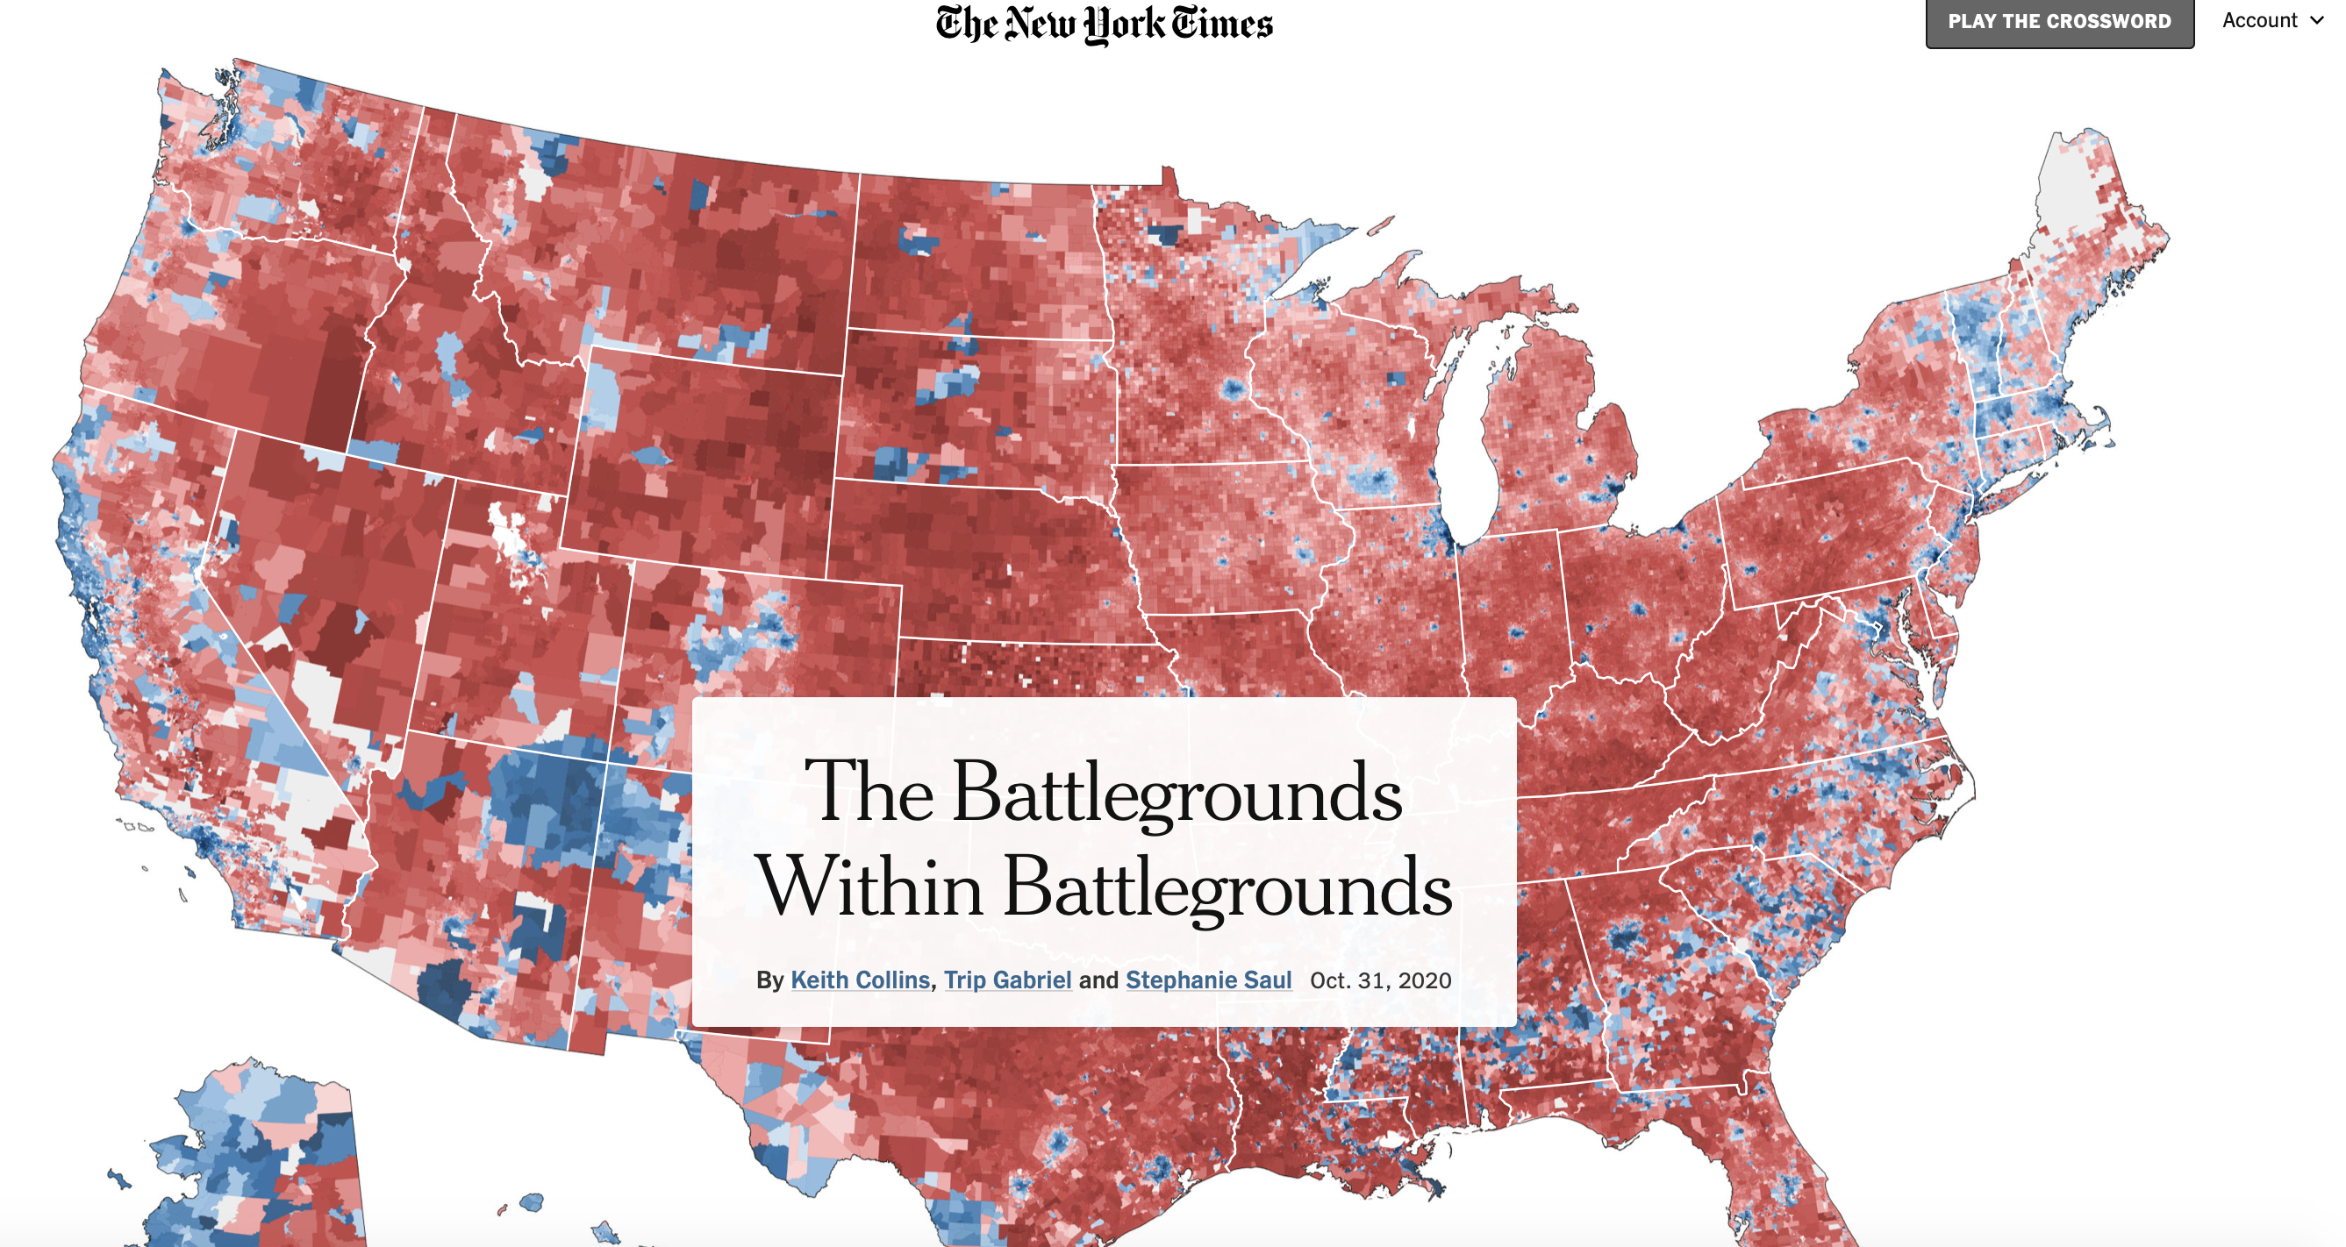

Slide 26
Principles of GIS
Working Principles → Data Management → Projections → Data Types → Errors → Layout → Software

Slide 27
Data Management
GIS data is diffuse, found in about 1000 different repositories
Governmental
Nonprofit
Educational
Research
Individual papers
Consortiums
Private
File structure complex – one elevation dataset may have 6+ individual files, that all get compiled upon use in software
File size can be massive: my master elevation dataset for Western India is several gigabytes!
In a GIS software, proliferation of “layers” mandates good naming schemes, efficient data storage, and logical file structure

Slide 28
LAWS OF GIS Law 1: Pick a naming scheme, file structure, data format that suits you. Keep it consistent and document every choice you make throughout a project!

Slide 29
Coordinates & Projections
We use coordinates to define the “where” on a map
Easting and Northing
X and Y
Latitude and Longitude
However, defining where something is may not be straightforward
Maps are a flat surface, and the earth is 3D. There is inherently distortion converting coordinates from 3D to 2D
Need to consider that the Earth is not a sphere
Error in spatial measurements
Physical location of an object changes through time

Slide 30
Coordinates & Projections
The coordinates of a spatial object depends on
A reference system (or datum) defining shape of the Earth
A projection, or mathematical transformation from spherical --> Cartesian coordinates
The error inherent in the measurement of the feature
The change of position with respect to time or space
In defining a coordinate system, you essentially want to be able to convert between X, Y, Z in 2D space and Lat, Long, Height in spherical space
No spatial analysis can be done accurately without this very important step!!

Slide 31
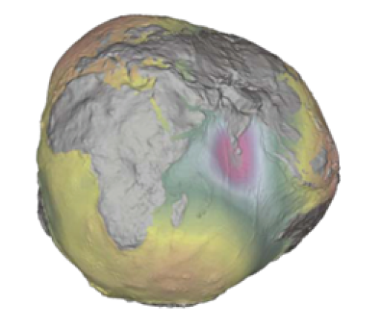
Early + Modern attempts to define the shape of the Earth
Pythagoras, Aristotle reasoned Earth must be a sphere
Eratosthenes (276 -194 BCE, Libya) measured circumference of the Earth to within 4% of modern accepted value
Ptolemy (90-168 CE, Egypt) set the accepted standard shape of the Earth
Aryabhatta (476-550 CE, Bihar, India) got within 70 miles of correct equatorial circumference
Abu Rayhan Biruni (973-1048 CE, Uzbekistan) held most accurate measurements of Earth’s radius until the Enlightenment in Europe
18th century saw geographers characterize Earth as an ellipsoid rather than a sphere
Clarke and Bessel ellipsoids popular in 19th century NA and Europe, respectively
“We define the geoid as the three-dimensional
equipotential surface, along which the
pull of gravity is a specified constant” – Bolstad Ch. 3

Slide 32
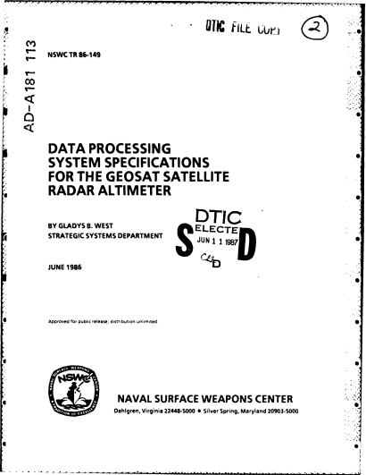

A Hidden Figure– Glady West
Developed the geoid model that went in to
building the first global position system in the 1980s

Slide 33
Coordinates & Projections
We reference the geoid as our “zero-height” 3D baseline for spatial locations on, above, or below Earth
Geoid defined by gravity, and is fixed regardless of atmospheric or oceanic processes
We start with horizontal and vertical reference systems, or datums, to define the position of an object relative to the ellipsoid
There are several main ellipsoids to choose from (e.g. WGS84)
Next, we define the projection system, which converts our ellipsoidally-referenced positions to a flat, 2D map.
This is where the dizzying array of projection systems comes in!
Choice of projection has been a topic of recent debate and controversy

Slide 34
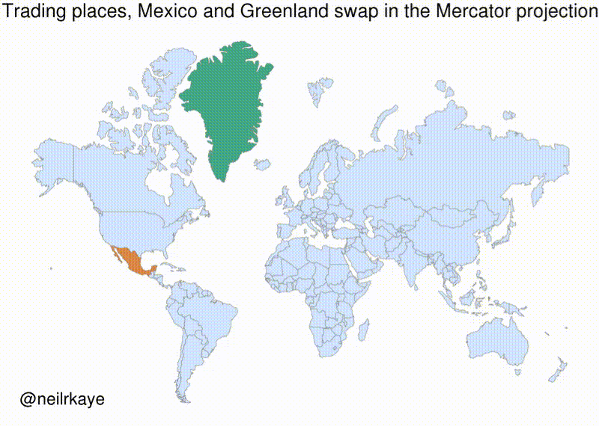
www.thetruesizeof.com

Slide 35
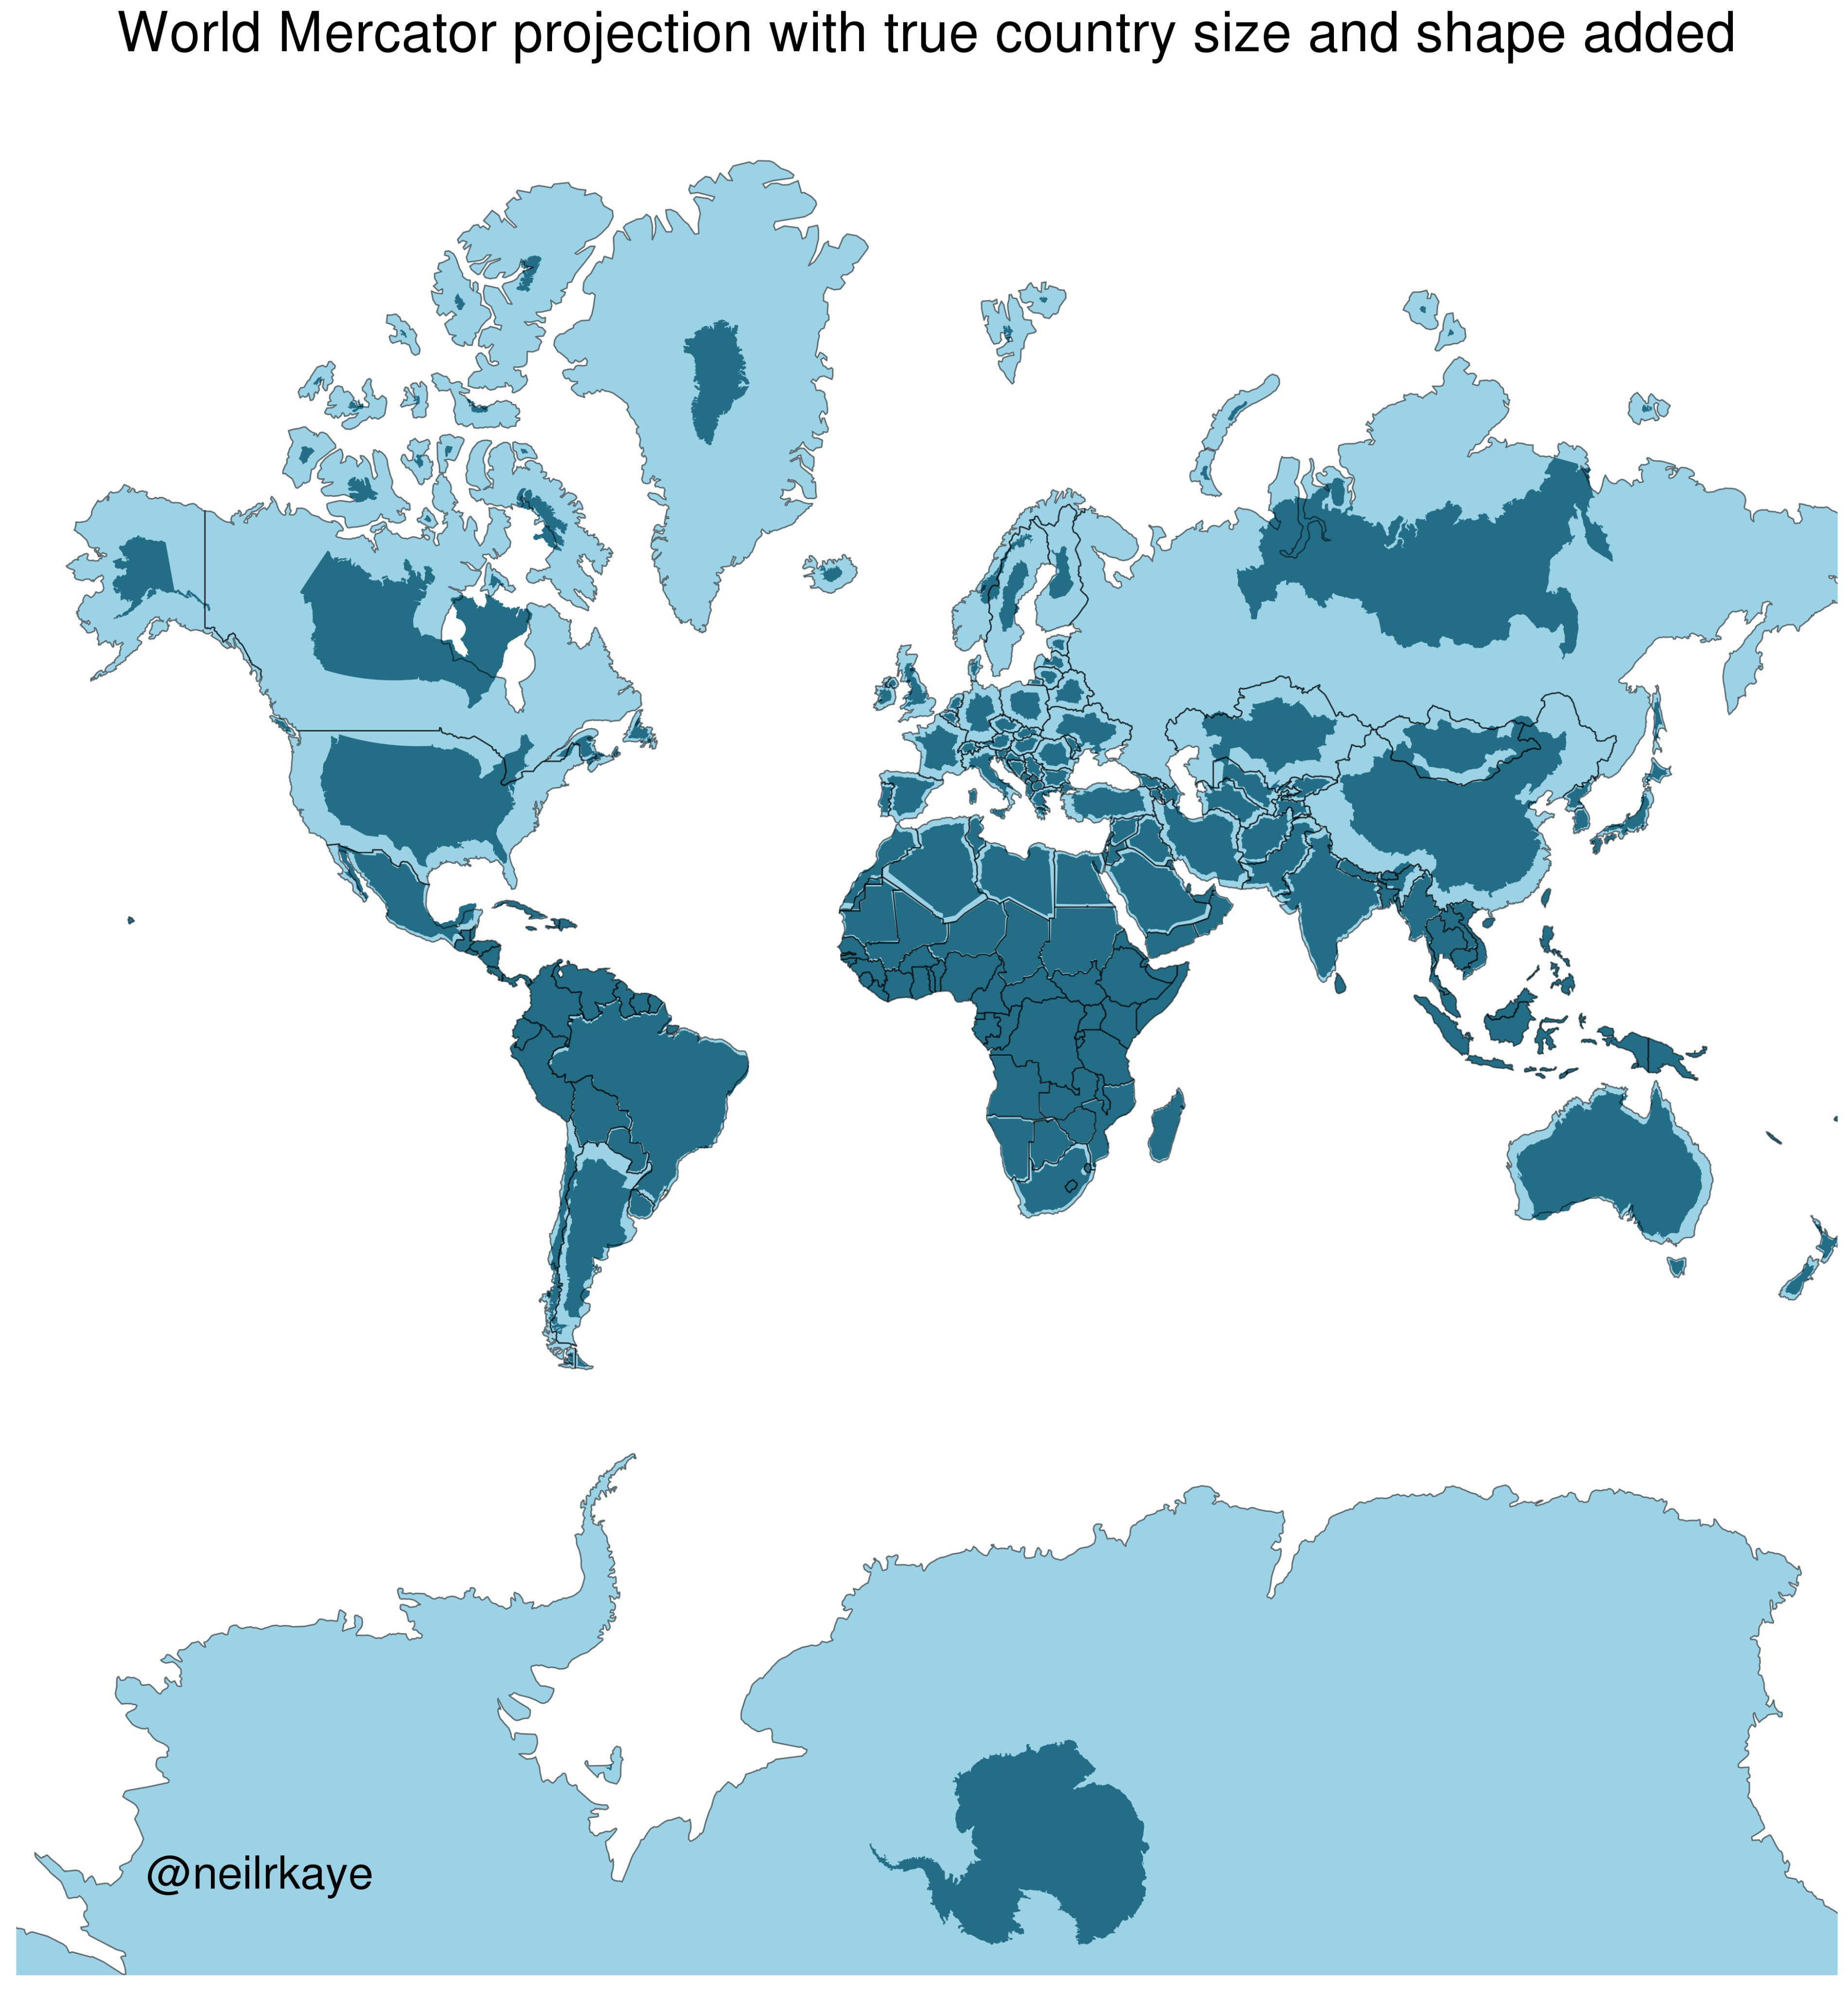

Slide 36
Law 2 : Known your coordinate system and make every layer in a project use the same system!! This needs to be done prior to any analysis

Slide 37
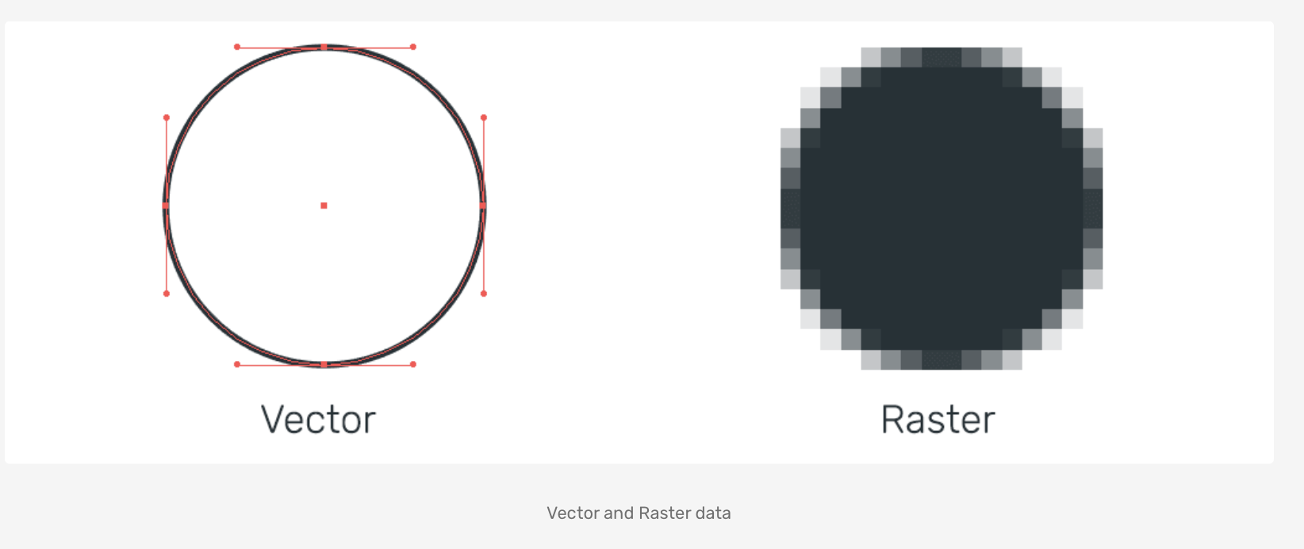
Data Types
VECTOR DATA
Essentially, a spreadsheet that is visualized by a geometry
Geometries include Point, Line, Polygon, Multiline, Multishape, etc.
Common format: Shapefile (.shp), Geopackage (.gpkg), File Geodatabase, KML, CSV, GeoJSON
Relevant data stored in an ATTRIBUTE TABLE
RASTER DATA
Digital image, with data stored in discrete cells of a specific resolution & spectral value
Efficient way to store and present large amount of data
Common formats: GeoTIFF, ESRI Grid, GDAL VRT, etc.
Common uses: Elevation, satellite data

Slide 38
Law 3 : Design a project with these data types in mind!

Slide 39
Errors
Sources of error abound in a GIS:
Accuracy of datum and projection system
Positional accuracy of data
Measurement accuracy
Map Scale accuracy
Tied to original scale at which data was mapped, not the scale at which you do the analyses
Quantitative accuracy of attribute data
Conceptual accuracy
How accurate it is it to cluster features into different groups?
Knowledge of User
“Human Error”
For example: estimated error introduced by manually tracing geological boundary in a GIS

Slide 40
Law 4 : Enumerate error sources at the start of a project, and document error + error propagation as you go!

Slide 41
Layout + Design
Aesthetic choices when presenting your work are scientific decisions. Also a form of data!
Color scheme
Scales
What you chose to show vs. what you didn’t
How much detail do you give your reader?
What kind of message are you sending your audience?

Slide 42
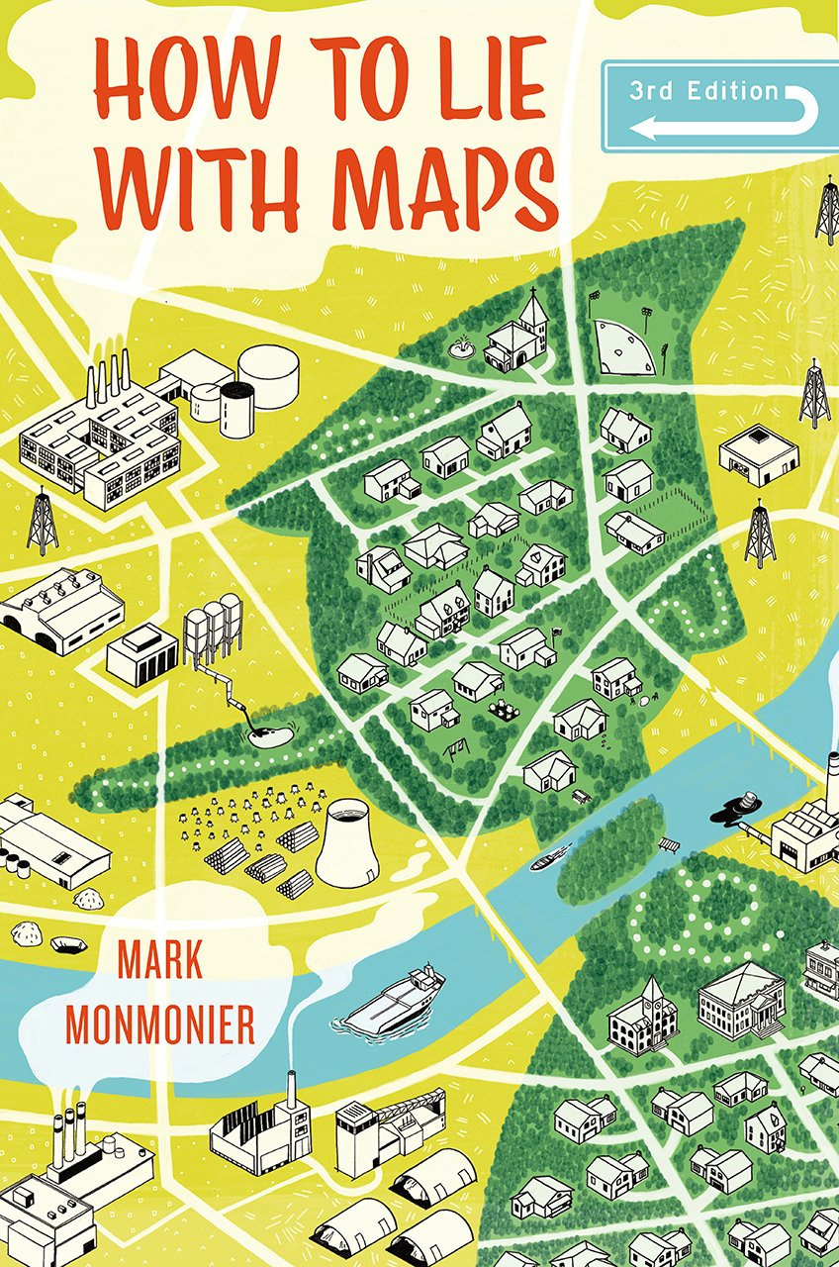
“Not only is it easy to lie with maps, it’s essential. To portray meaningful relationships for a complex, three-dimensional world on a flat sheet of paper or a screen, a map must distort reality.” – M. Monmonier
Need to ask yourself: How am I distorting reality when making this map?

Slide 43
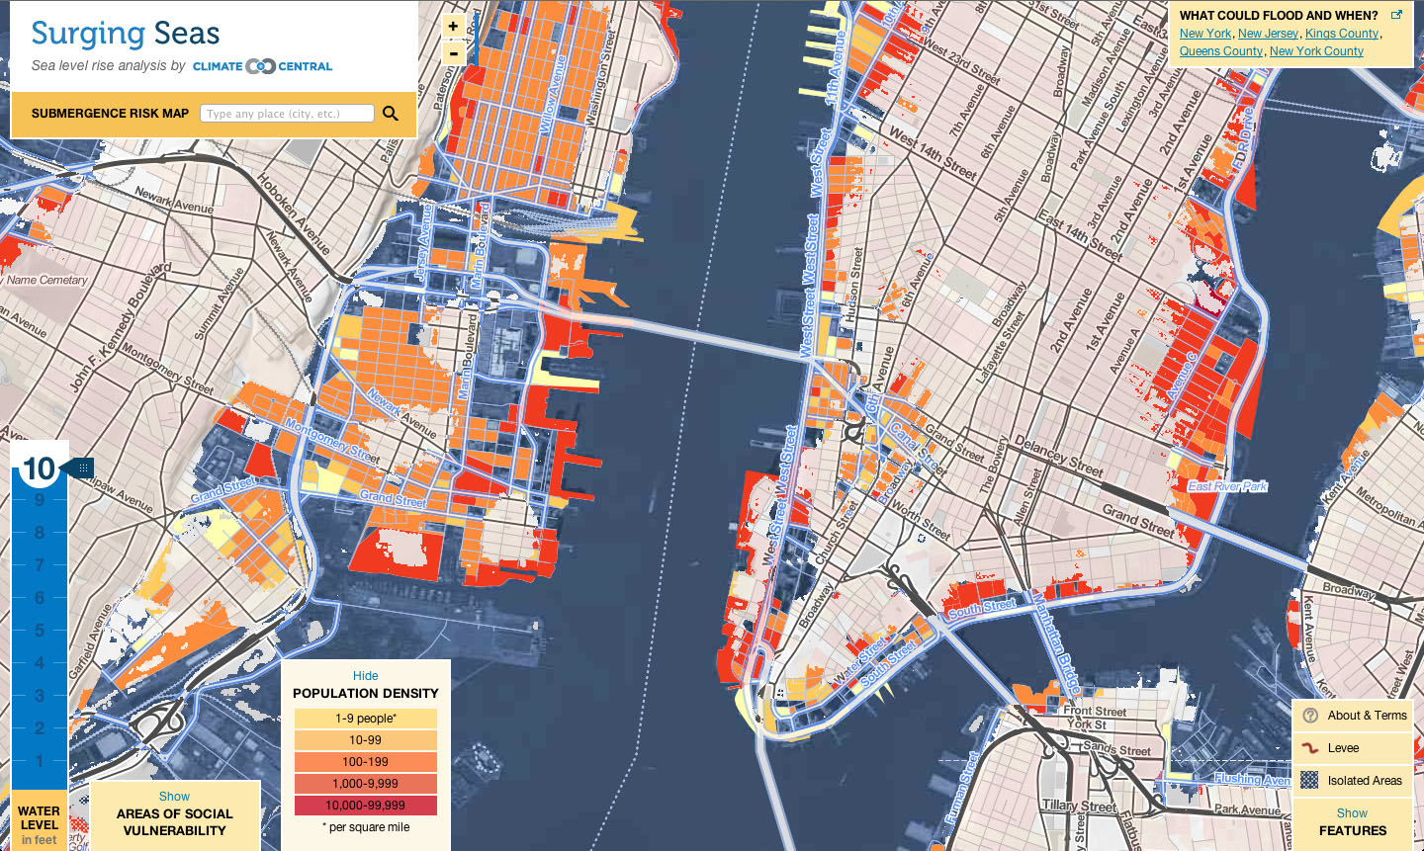
Layout + Design
Essential, and one of the most challenging/impenetrable aspects of GIS
Based on principles of design + cartography
Need visualization to be as elegant as it is accurate
Remember data reusability!
Underlying data accessible and well documented

Slide 44
Law 5 : Design is as important as the data– treat any GIS output as you would any figure in a paper!

Slide 45


Software: The Two Juggernauts
ESRI’s ArcMap
Quantum GIS (QGIS)
Proprietary & Industry Standard
The Gold Standard
Comes with a range of products, like Story Maps, ArcGIS Online, Customer support, 3D Viz, other Advanced tools
Data formats are often proprietary and closed-source
Algorithms + data structure can be opaque and hard to reference
Open source, community driven
Not as feature rich but a fast-rising competitor to Arc
Integrated with other open source projects like SAGA, GDAL, Python, PostGreSQL, GRASS GIS, etc.
Can read/process almost any data type
Interface can be clunky
Software dependency issues

Slide 46
Software: The Two Juggernauts
ESRI’s ArcMap
Quantum GIS (QGIS)
Proprietary & Industry Standard
The Gold Standard
Comes with a range of products, like Story Maps, ArcGIS Online, Customer support, 3D Viz, other Advanced tools
Data formats are often proprietary and closed-source
Algorithms + data structure can be opaque and hard to reference
Open source, community driven
Not as feature rich but a fast-rising competitor to Arc
Integrated with other open source projects like SAGA, GDAL, Python, PostGreSQL, GRASS GIS, etc.
Can read/process almost any data type
Interface can be clunky
Software dependency issues

Slide 47
Law 6 : Keep in mind the audiences and limitations of each software. Make your software choice early, and stick with it!

Slide 48
Introducing QGIS 3.10
A fly-by-tour of the best open source GIS software – Quantum GIS

Slide 49
Overview of QGIS 3.10
Installation
Opening up for the first time
Introduce layout
Browser
Layers
Various menus
Processing
Plugins
Layout
Project Settings
Properties
Symbology

Slide 50
On to the real thing!

Slide 51
For Next Time…
Make sure QGIS in installed
If you have any problems, contact me
Download latest version of the QGIS Live Demo Guide (on Moodle)
Try importing some of the data on the GitHub (found under ‘qgis’ folder).
You can find instructions on the basics of QGIS in the guide
Complete the Lecture 1 Feedback form: https://forms.gle/JP23T5J9RA36WzCg6

